Slide 1
Fire and Ice
Some say the world will end in fire,
Some say in ice.
From what I’ve tasted of desire
I hold with those who favour fire.
But if it had to perish twice,
I think I know enough of hate
To say that for destruction ice
Is also great
And would suffice.
Robert Frost

Slide 3
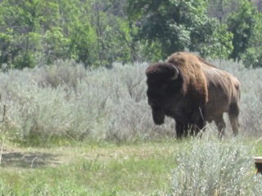

Slide 4
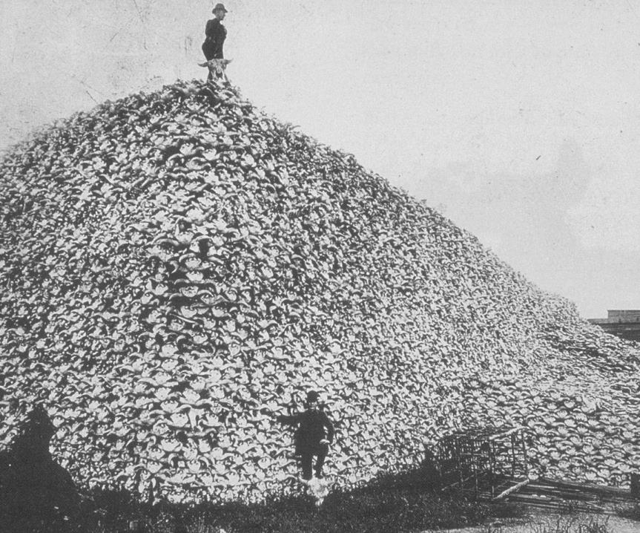

Slide 5
“Canadians need to realize that we are their last best hope at saving the lands, waters, plants, animals and resources for future generations because our Aboriginal and treaty rights are constitutionally protected.”
Pam Palmateer

Slide 6
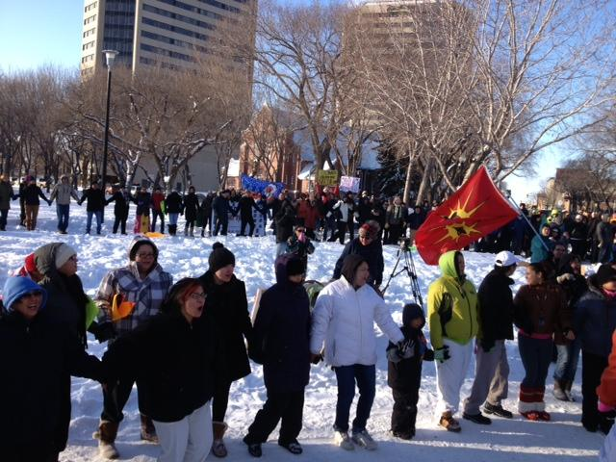

Slide 7
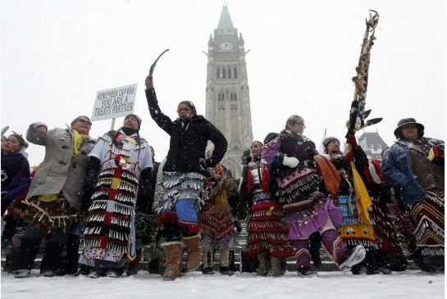

Slide 8
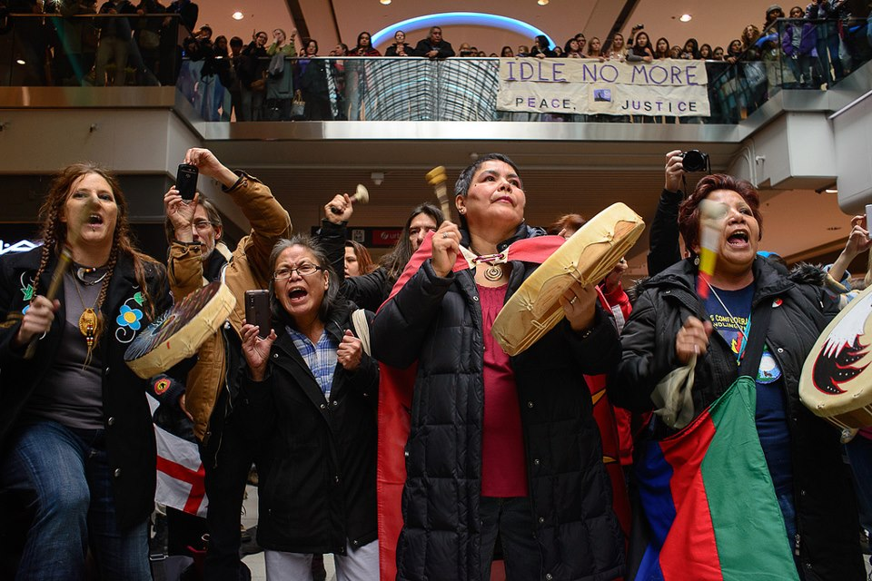

Slide 9
Plebeian 1 How do you un-ring the bell?
Caesar Ha! Who calls?
Plebeian 2 If we could have back what’s been lost and stolen,
Plebeian 3 Could we rebuild what’s been lost and stolen?
- Death of a Chief

Slide 10
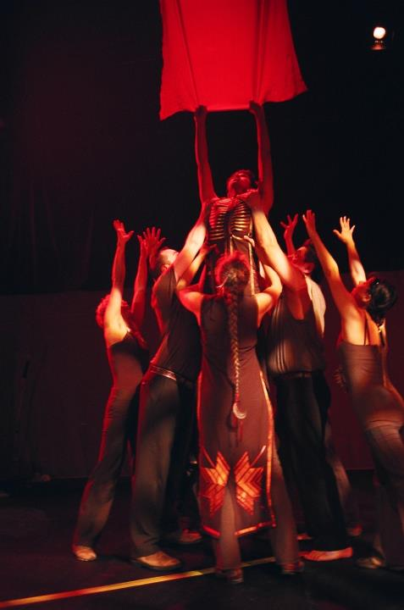

Slide 11
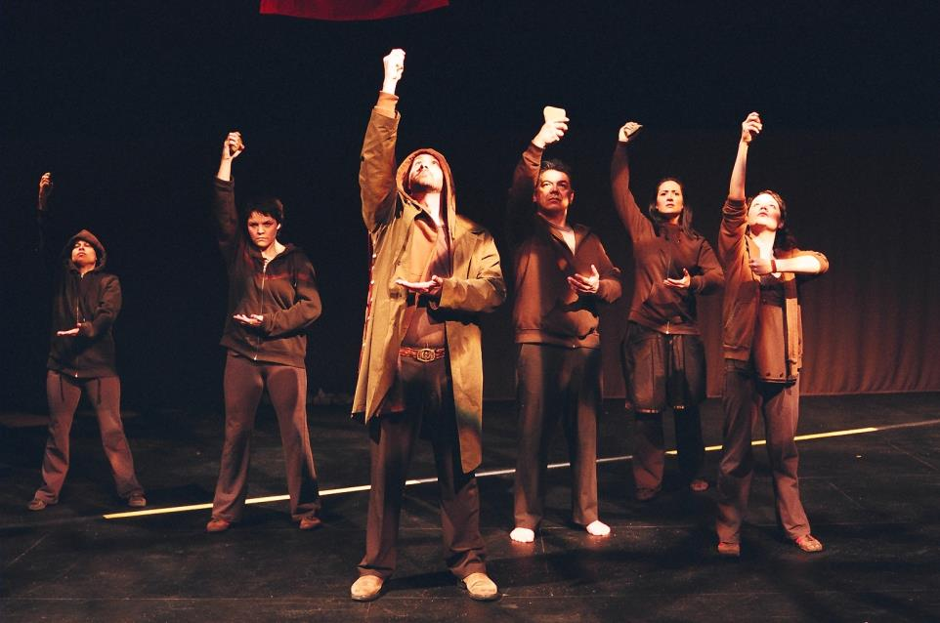

Slide 12
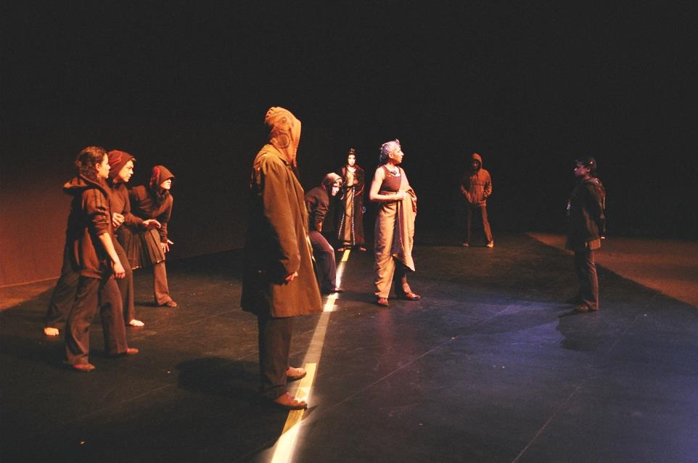

Slide 14
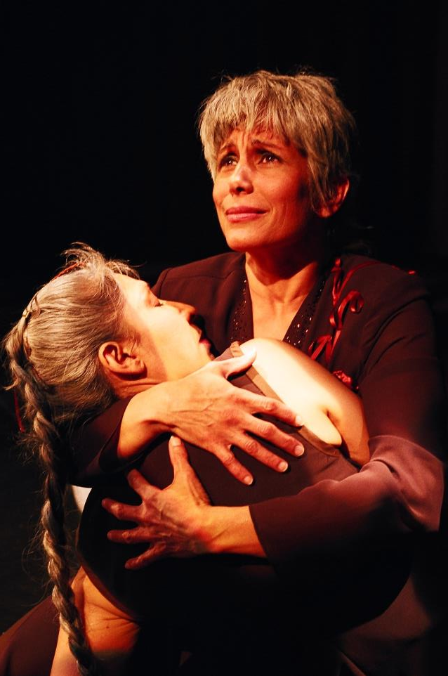

Slide 15
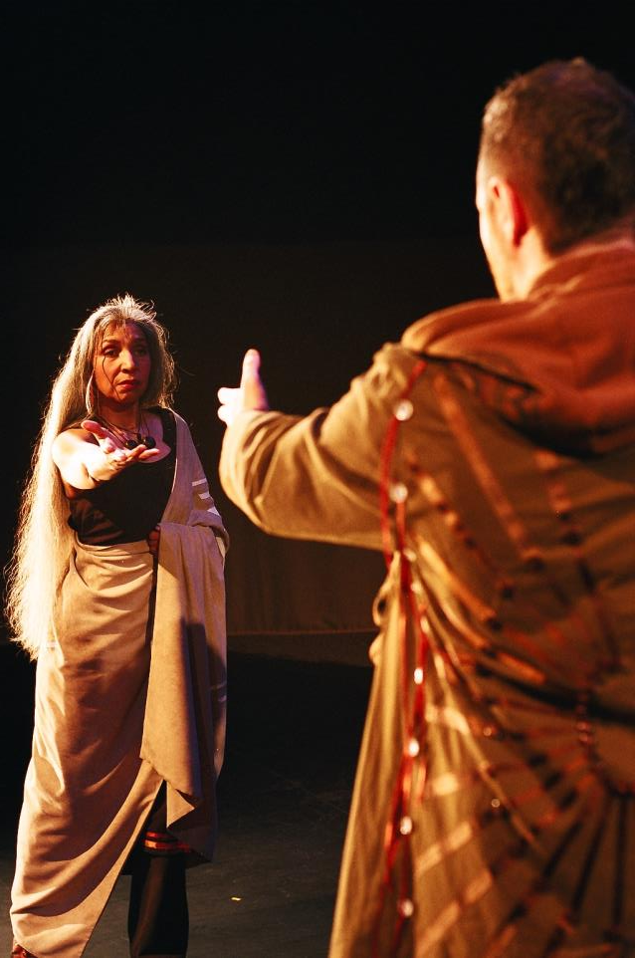

Slide 16
“Some say in ice…”

Slide 17
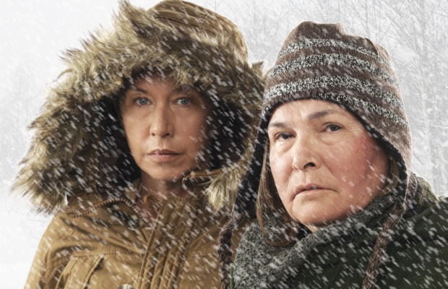

Slide 18
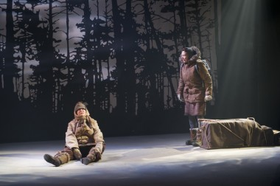

Slide 19
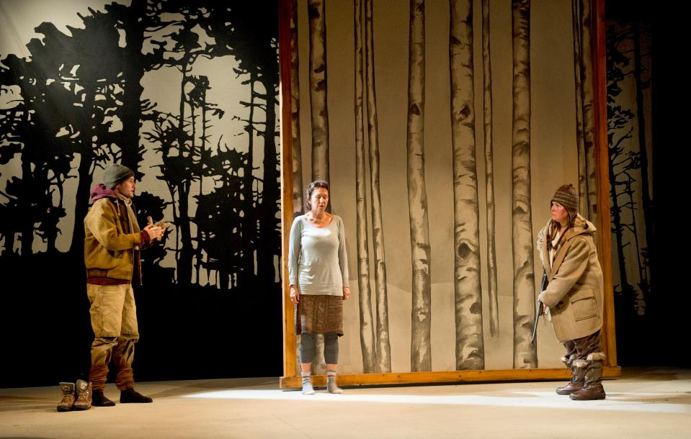

Slide 20
“We left the cities to men
Who resolutely choose empire over the health
And well being of their own.”
Eagle, The Birds

Slide 21
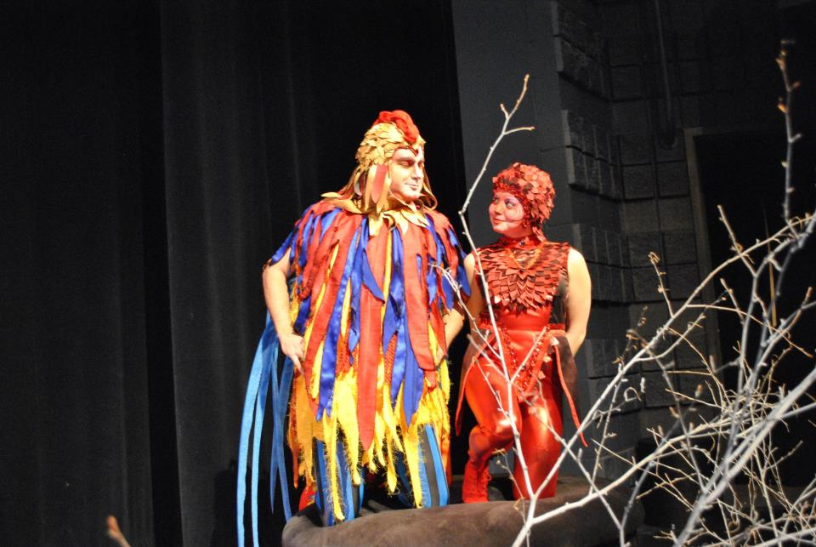

Slide 22
Waka
Ciimaan

Slide 23
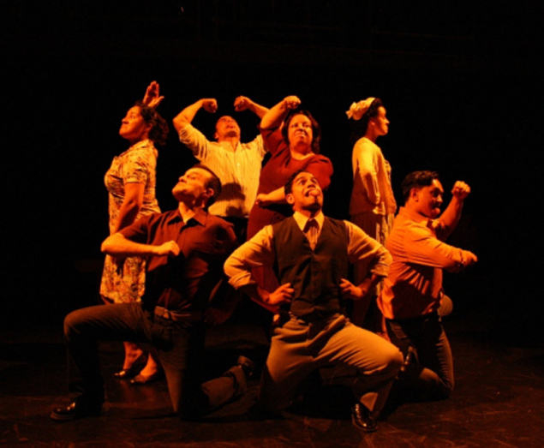

Slide 24
Justice

