Slide 1
Notes:
The mission of The Arctic Cycle is to support the writing, development and production of eight plays that explore the impact of climate change on the eight countries of the Arctic. Operating on the principle that complex problems must be addressed through collaborative efforts, each play will engage artists across disciplines as well as geographic and cultural borders; solicit input from earth and social scientists; and actively seek community and educational partners to expand the scope of the plays and provide strategies for action.

Slide 2
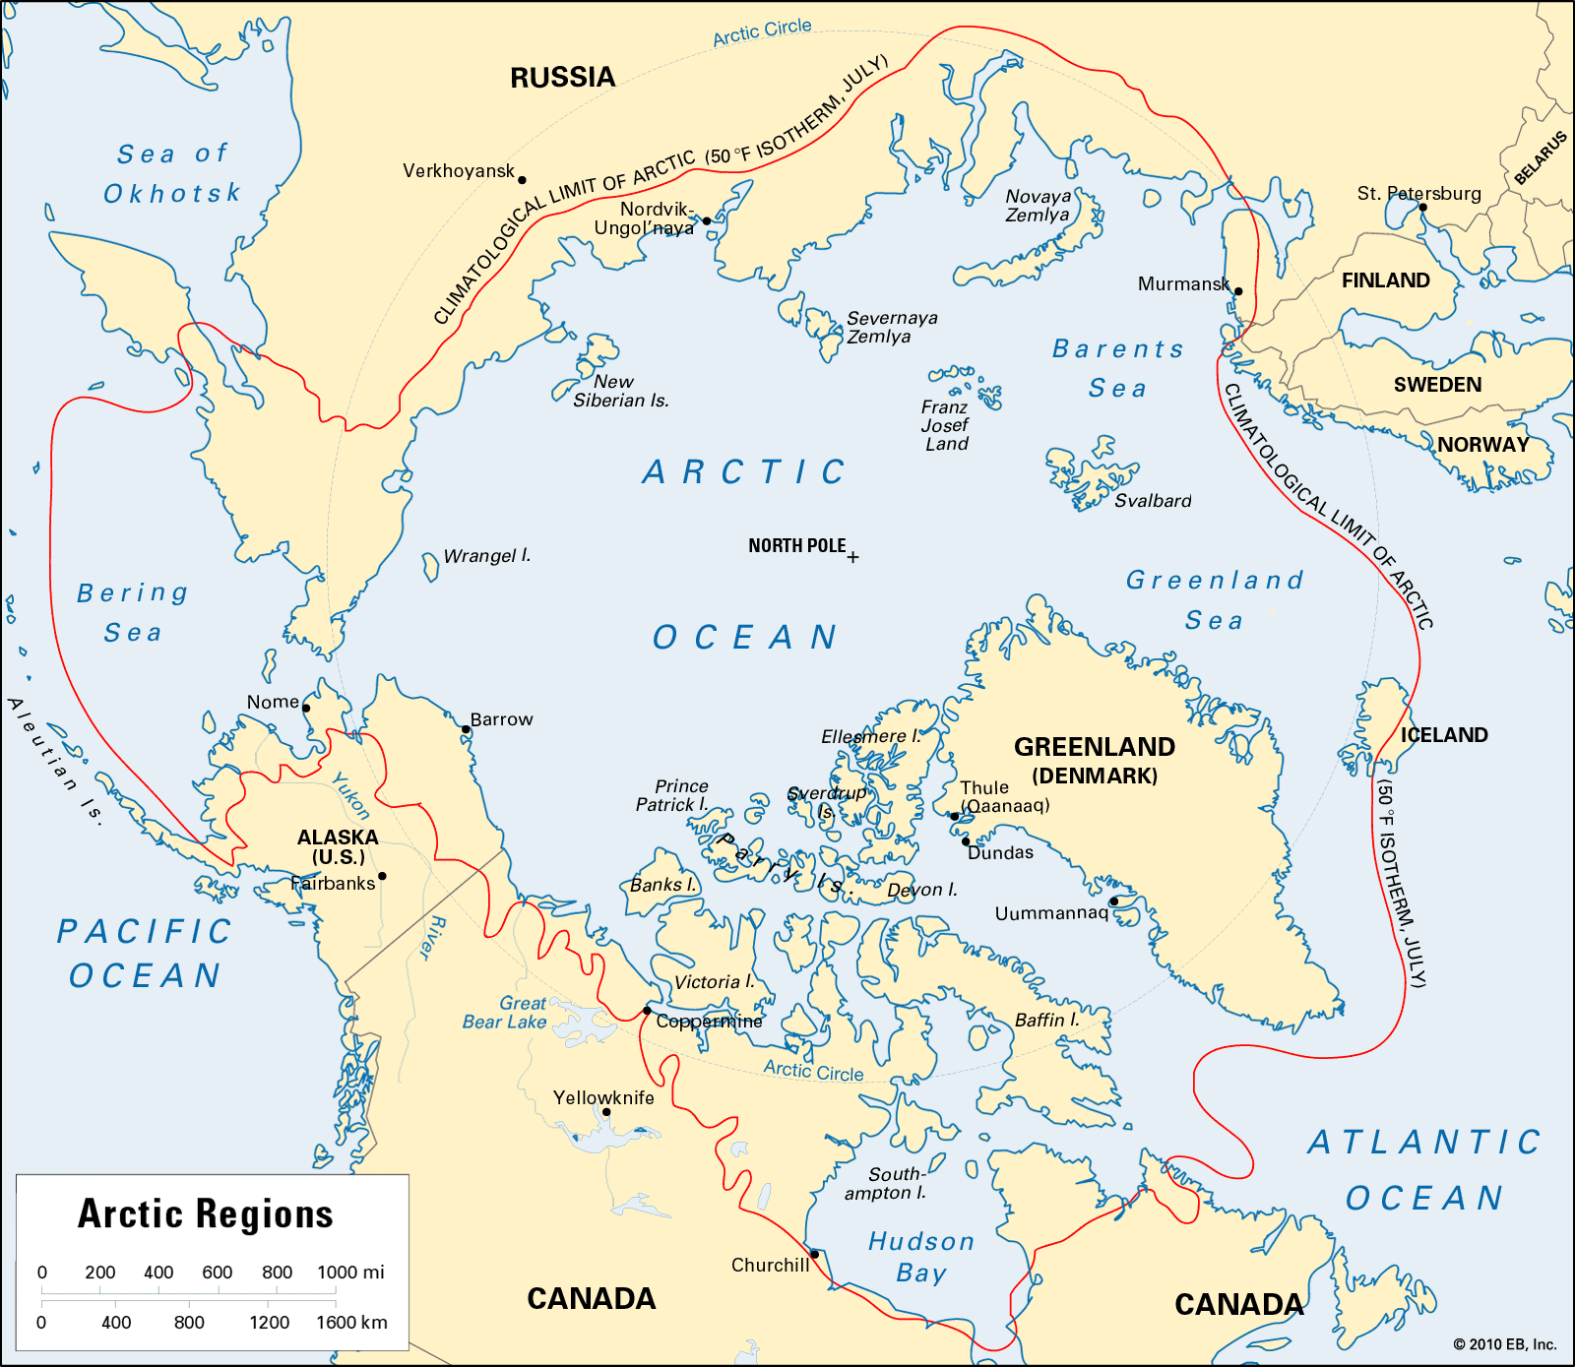
Notes:
Countries of the Arctic.

Slide 3
Goals
Raise awareness of climate change in the Arctic
Tell personal stories that engage the audience’s imagination and instill a sense of hope
Provide a stepping stone for people to engage in cross-disciplinary conversations

Slide 4
Strategies
Extensive research
On-site visit
Consultation with “experts”
Collaboration with local artists
Partnership with community & educational institutions

Slide 5
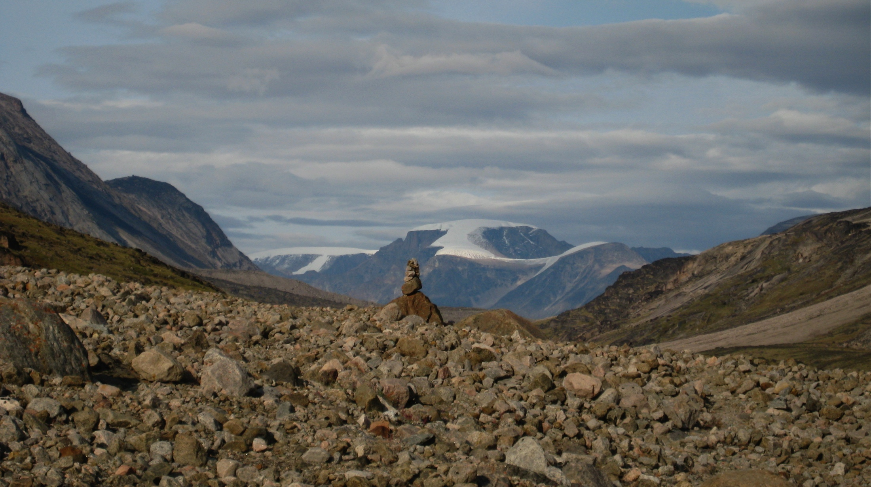
Play #1: Sila (Canada)

Slide 6
Play #1: Sila (Canada)
Notes:
• What the play is about.

Slide 7
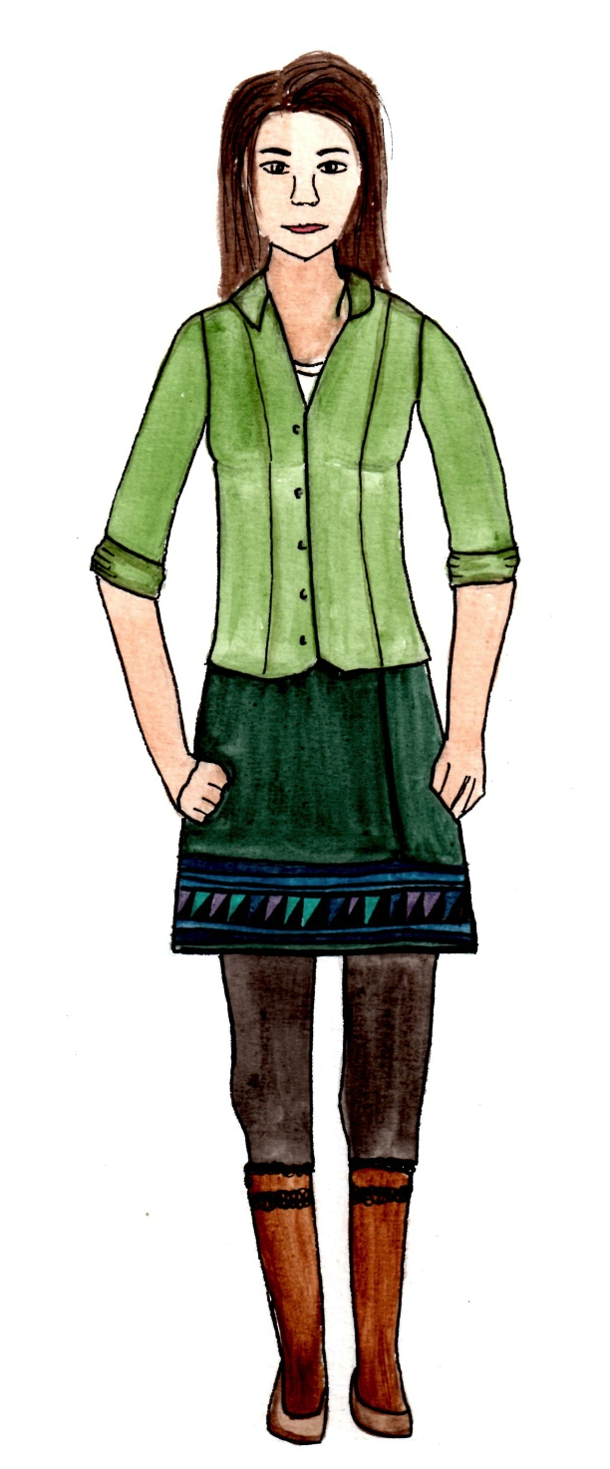
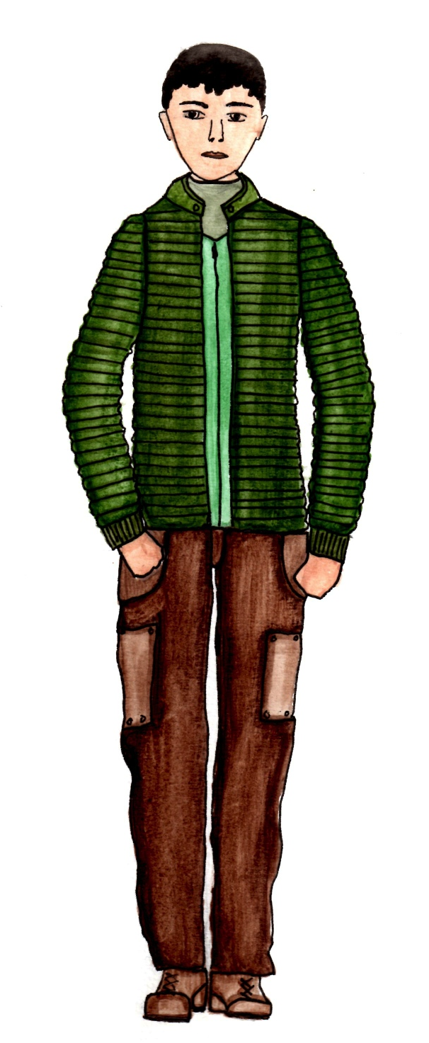
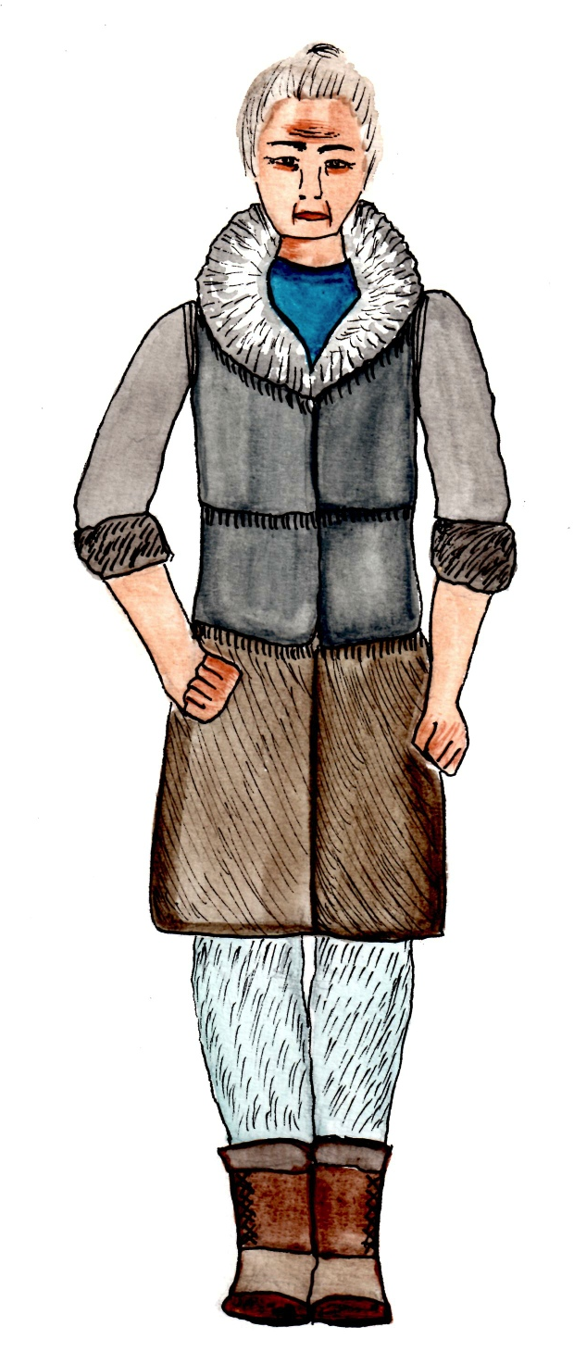
Play #1: Sila (Canada)
Notes:
• What the play is about.

Slide 8
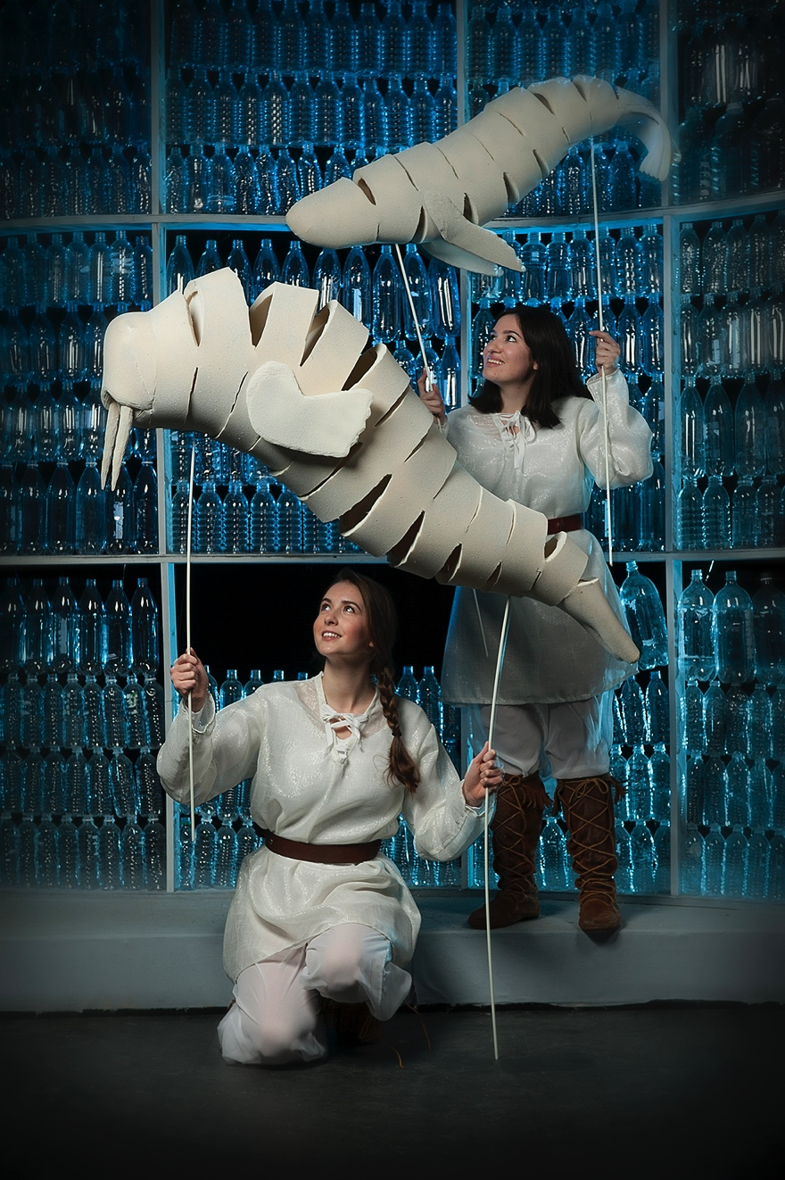
Play #1: Sila (Canada)
Notes:
• What the play is about.

Slide 9
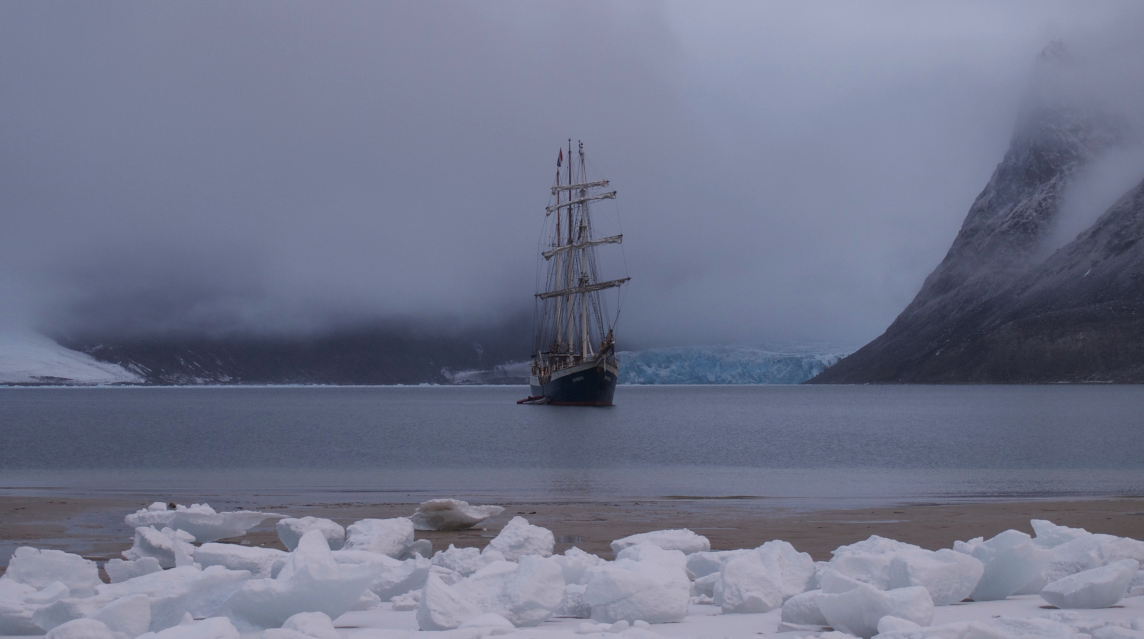
Play #2: Forward (Norway)

Slide 10
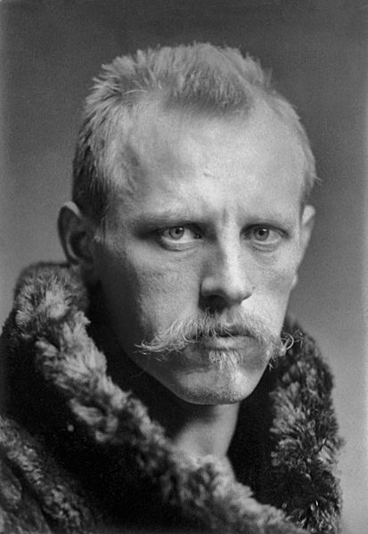
Play #1: Sila (Canada)
Notes:
• What the play is about.

Slide 11
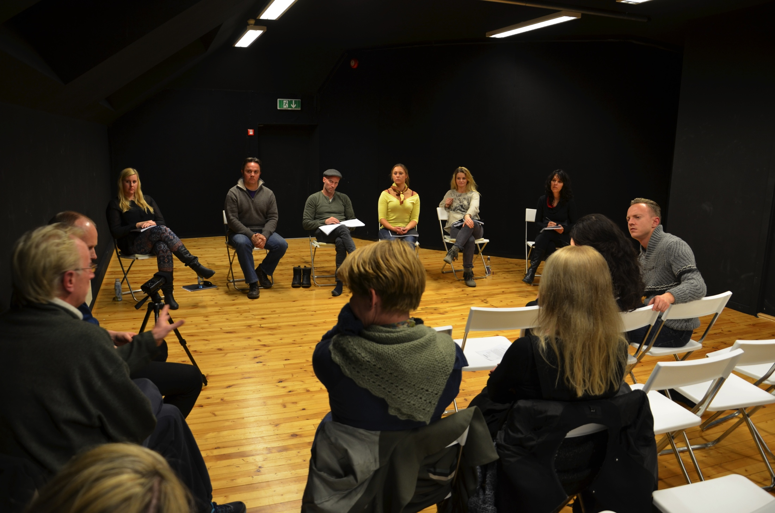
Notes:
• What the play is about

Slide 12
Useful Reminders
I am not teaching climate science
Don’t repeat what’s already in the media
The play should ask questions rather than provide answers
New paradigms require new forms

Slide 13
Aesthetics
Multiple narratives
Multiple disciplines
Multiple languages
Spirituality
Sustainability

Slide 14
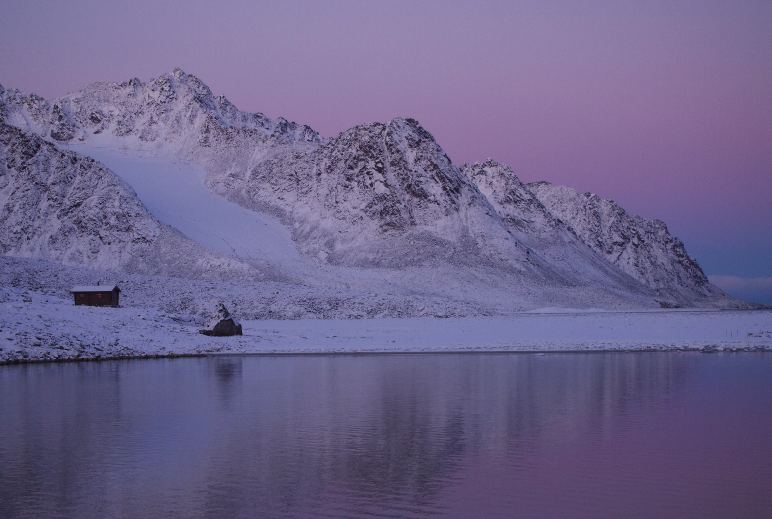
Thank you
www.arcticcycle.org
chantal@cbilodeau.com

